Slide 1
Data Mining: A practical perspective
Text Mining
Miguel Vázquez García
Structural Biology and Biocomputing Programme
Spanish National Cancer Research Centre (CNIO)
Madrid - July 4th to July 15th, 2011

Slide 2
Outline
Why is text mining needed?
What is natural language processing?
Words, syntax and semantics
Corpora
Information retrieval
Information extraction
Text categorization

Slide 3
Bibliography
Natural language processing for online applications: text retrieval, extraction and categorization. Peter Jackson and Isabelle Moulinier. John Benjamins Publishing Company. 2nd revised edition. 2002.
Text mining for Biology and Biomedicine. Sophia Ananiadou and John McNaught. Artech House Publisher. 2005.
A Survey of Current Work in Biomedical Text Mining. Aaron M. Cohen and William R. Hersh. Briefings in Bioinformatics. 6(1):57-71. 2005.
Information retrieval. Ricardo Baeza-Yates, Berthier Ribeiro-Neto. Modern Reading, Massachusetts: Addison-Wesley Longman. 1999.

Slide 4
Why is text mining needed? (overview)
Derived from data mining (discover of patterns in data)
Huge amount of digital text available:
  WWW: news, blogs, scientific publications, etc.
  clinical reports, e-mails, etc.
Uncover new knowledge between the text and the world
Extract useful metadata from large digital repositories

Slide 5
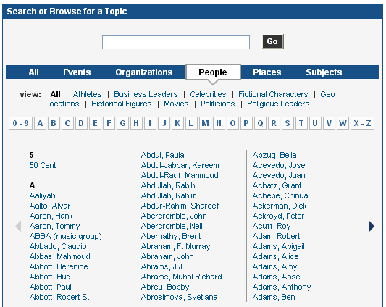
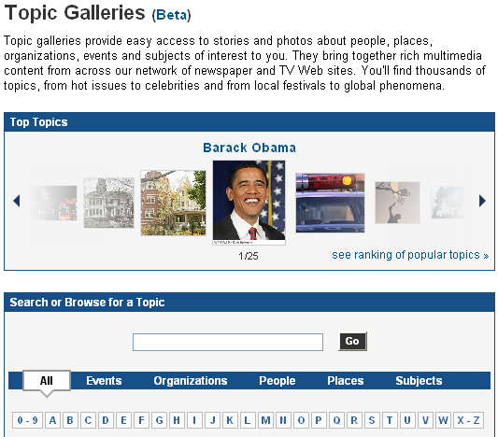
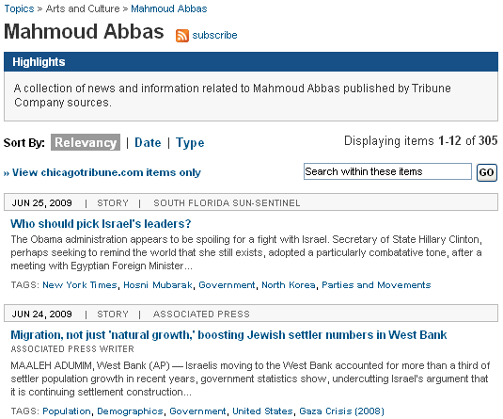


Why is text mining needed? (examples)

Slide 6
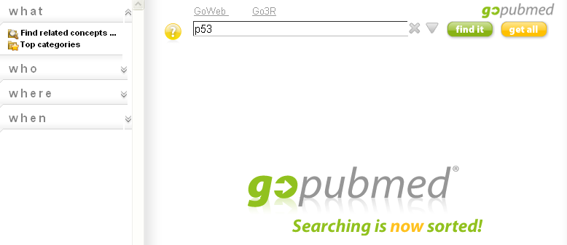
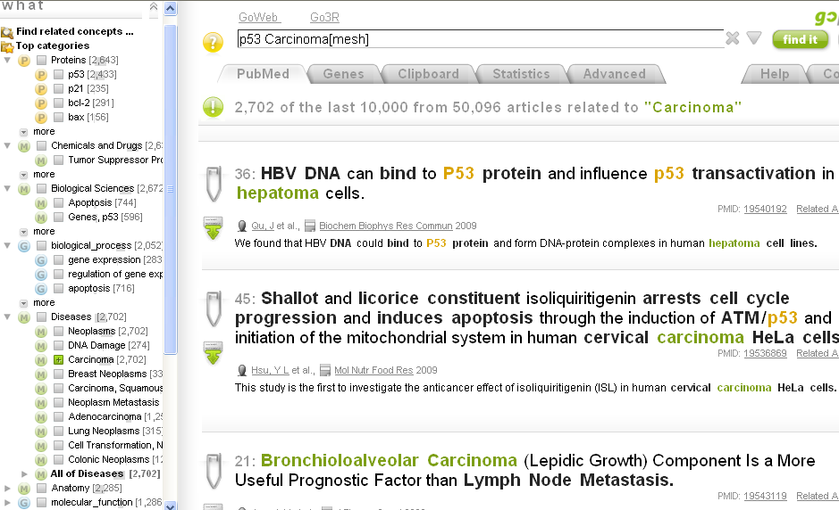
Why is text mining needed? (examples)

Slide 7
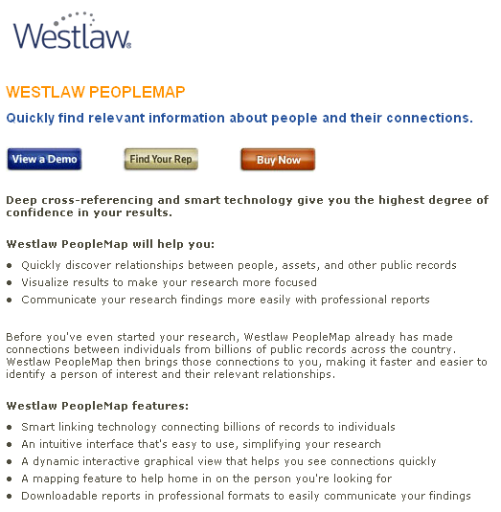
Why is text mining needed? (examples)

Slide 8
What is natural language processing?
“Software component in a computer system which analyze and synthesize spoken or written language.” P. Jackson & I. Moulinier
Why “natural”? In opposition of structured languages:
  Mathematical or logical notations
  Computer languages
World Wide Web ≈ natural language
Ambiguity
  Lexical, Syntactic, Semantics

Slide 9
What is natural language processing?
Lexical ambiguity or Polysemy (http://en.wikipedia.org/wiki/Polysemy)
  “consists in the word having more than one meaning in the language to which the word belongs”
“to get”
  “take” (I'll get the drinks)
  “become” (she got scared)
  “have” (I've got three dollars)
  “understand” (I get it)

Slide 10
What is natural language processing?
Syntactic ambiguity (http://en.wikipedia.org/wiki/Syntactic_ambiguity)
  “a property of sentences which may be reasonably interpreted in more than one way”
“They are hunting dogs.”
  “they” are hunting for dogs
  those dogs are a type known as “hunting dogs”

Slide 11
What is natural language processing?
Two views of NLP
  Symbolic (top-down): Rules for the manipulation of symbols, e.g. imposing known grammatical patterns that defines if a sentence is well-formed
  Empirical (bottom-up): deriving language data from relatively large text sets, looking for patterns and associations to model

Slide 12
What is natural language processing?
NLP tasks (may be combined)
  Information retrieval (Google)
  Information extraction (extract people name from a doc)
    Document summarization (summarize one or more docs)
  Document classification (spam filtering)
    Document routing (news feed)
    Document indexing (selection of keywords to a doc)

Slide 13
Words, syntax and semantics
Syntax
  The analysis of grammatical structures
Semantics
  The analysis of meaning
Pragmatics
  The analysis of context or language use

Slide 14
Words, syntax and semantics
Syntax versus Semantics
“Furiously sleep ideas green colored”
(syntactically anomalous)
“Colorless green ideas sleep furiously”
(grammatically well-formed, semantically anomalous)

Slide 15
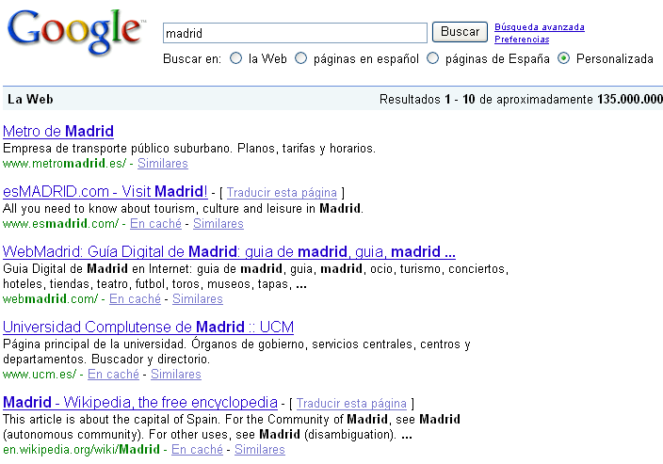
Words, syntax and semantics
Pragmatics and Context
transportation
tourism, fun
university
Wiki

Slide 16
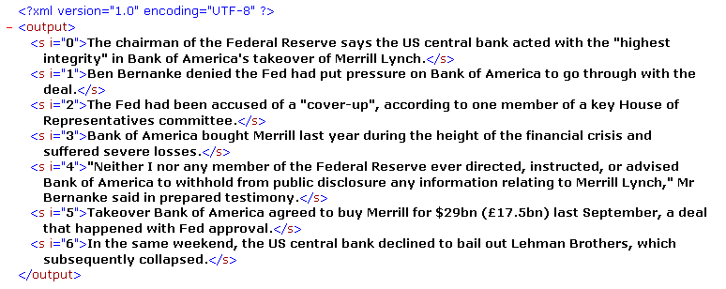

Words, syntax and semantics
(Linguistic tools)
Sentence splitter
  Separated by punctuation signs: . ? !
  Caution with decimal points, abbreviations, “Mr.”, etc.

Slide 17
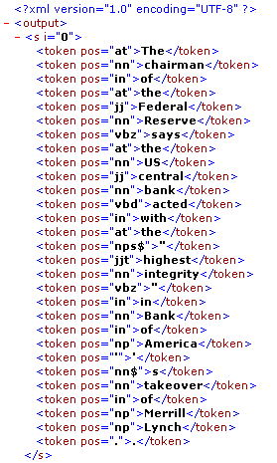
Words, syntax and semantics
(Linguistic tools)
Tokenizer
  Usually separated by white spaces
  Caution with punctuation signs, e.g. “1,005.98”, “$1,005.98”

Slide 18
Words, syntax and semantics
(Linguistic tools)
Stemmer
  Associates variants of a the same term with a root form
  “go”, “goes”, “going”, “went” → root “go”
  Makes use of rules or lexicon
  Inflectional morphology: syntactic relations of the same grammatical tag (singular/plural, past/present tense):
    dog/dogs (nouns), goes/go/going/went (verbs)
  Derivational morphology: involves change in the grammatical tag, and sometimes change in the meaning:
    inflate (verb), inflation (noun)

Slide 19
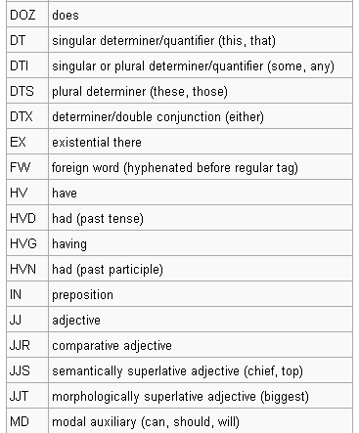
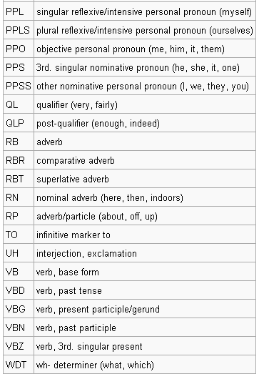
Words, syntax and semantics
(Linguistic tools)
Part-of-speech tags
  Assign grammatical tags to tokens
  Rule-based
  stochastic (training data)
    Hidden Markov Model, maximum entropy

Slide 20
Words, syntax and semantics
(Linguistic tools)
Parser
  Defined formal grammar
  Set of rules that say which combinations of which parts of speech generate well-formed phrase and sentence structures
Furiously
sleep
ideas
green
colorless.
Colorless
green
ideas
sleep
furiously.
ADVERB
VERB
NOUN
ADJECTIVE
ADJECTIVE
ADJECTIVE
ADJECTIVE
NOUN
VERB
ADVERB
ADVERB
VERB
NOUN
NOUN
ADJECTIVE
NOUN PHRASE
VERB PHRASE
ADVERB
NOUN
NOUN
ADJECTIVE
ADJECTIVE
ADVERB
NOUN
NOUN
NOUN
ADJECTIVE

Slide 21
Words, syntax and semantics
(Linguistic tools)
Parser (sentence representation)
S: green ideas
sleep furiously
NP: green ideas
VP: sleep furiously
ADJ: green
NOUN: ideas
VERB sleep
ADV: furiously
(S: (NP: (ADJ: Green) (NOUN: ideas))
VP: (VERB: sleep) (ADV: furiously))

Slide 22
Words, syntax and semantics
(Representation of a document)
Sentence splitter, tokenizer
Bag-of-words (order of the words is ignored):
  Binary (presence/absence)
  Weights based on the frequency of the terms
Sparse
Ignore stopwords (article, preposition, etc.)
Bigrams, trigrams
Document length normalization
Problems:
  High dimensionality (dimensionality reduction course)
  Noisy: words have more than one meaning

Slide 23
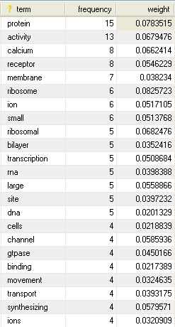
Words, syntax and semantics
(Representation of a document)
subfamily member cce1 strpc4 transient receptor
potential cation channel subfamily member trp4
trpc4 trrp4 dna binding interacting selectively
dna deoxyribonucleic acid microtubule chromatin
interaction plasmid binding transcription factor
activity function binding specific dna sequence
order modulate transcription transcription factor interact
selectively protein macromolecular complex structural
constituent ribosome action molecule contributes
structural integrity ribosome ribosomal protein ribosomal
rna receptor activity combining extracellular intracellular
messenger initiate change cell activity endoplasmic reticulum
receptor activity gpi anchored membrane bound receptor
immunophilin peroxisome integral membrane receptor
peroxisome receptor receptor guanylate cyclase activity ion
channel activity allows regulatable energy independent passage
ions lipid bilayer concentration gradient calcium channel
activity calcium ion binding interacting selectively calcium
ions ca2 calcium ion storage activity fibrillin intracellular
living contents cell matter contained including plasma
membrane usually taken exclude large vacuoles masses
secretory ingested material eukaryotes includes nucleus
cytoplasm protoplasm ribosome intracellular organelle
diameter consisting rna protein site protein biosynthesis
small containing protein rna ribosome subunits characterized

Slide 24
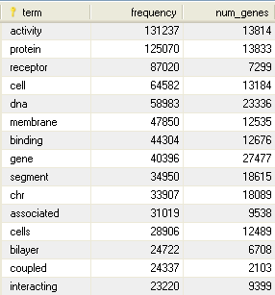
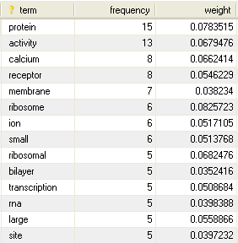
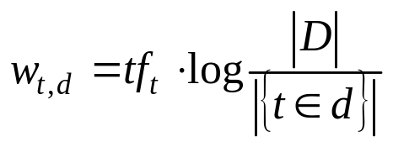
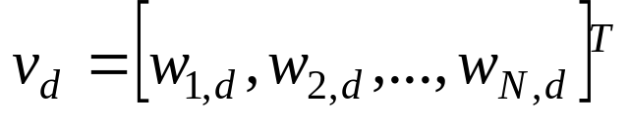
Words, syntax and semantics
(Representation of a document)
Vector Space Model
  Algebraic model for representing text documents as vectors of index terms.
  TF-IDF: term frequency – inverse document frequency
“log” to
compress the range
TF
IDF

Slide 25
Corpora
Large and structured set of annotated texts
Examples of annotations
  Linguistics: Part-of-speech tags, parsing, etc.
  Specific entities: People, companies, genes/proteins, etc.
Corpora:
  Linguistics: Brown (80 PoS tags), Penn Treebank (PoS tags, parsing), etc.
  Biomedical domain: BioCreative (genes/proteins)

Slide 26
Information retrieval
Acquisition, organization, storage, retrieval and distribution of information
Input: query (information need)
Output: relevant documents
Indexing: association of a documents with the terms that occur in it
Inverted index or inverted file: stores the terms of each document in order to allow a fast retrieval
  Per document: frequency, position
  Per token: document count, total frequency count

Slide 27
Information retrieval (inverted file)
Doc
Freq
Word position
Doc
Freq
Word position
Doc
Freq
Word position
0
2
0, 3
1
1
0
2
1
0
Doc
Freq
Word position
Doc
Freq
Word position
Doc
Freq
Word position
0
2
1, 4
1
1
1
2
1
1
Doc
Freq
Word position
Doc
Freq
Word position
Doc
Freq
Word position
0
1
2
1
1
2
2
1
2
Doc
Freq
Word position
2
1
3
Term
Doc count
Freq count
banana
1
1
is
3
4
it
3
4
what
2
2
http://en.wikipedia.org/wiki/Inverted_file

Slide 28
Information retrieval
Query processing
  Boolean search: AND, OR, NOT
  “computer /5 virus” (within 5 words)
  “assassin!” (stemming: assassination, assassinated, etc)
  Within paragraph or sentences
  Add synonyms, polysemy, regional variants
Large results set:
  Complex query logic
  Unordered result set
  Dichotomous retrieval
  Equal term weights

Slide 29
Information retrieval
Ranked retrieval
  Ranks search results based upon the frequency distribution of the query terms in the document collection
  Ignore stopwords, performs stemming
  Documents represented as a multi-dimensional vector space of terms

Slide 30
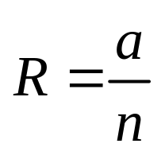
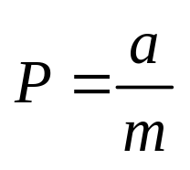
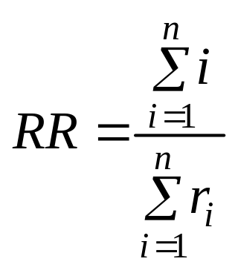
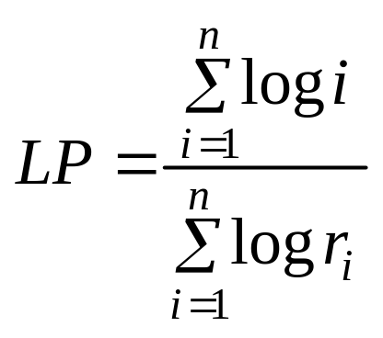
Information retrieval (Evaluation)
Recall and Precision
  Given a collection of N documents, and n<N relevant documents The system returns m items, a of which are actually relevant
  Ranked Recall and Log Precision
  Take into account the relevance of the documents
 | Relevant | Non-relevant
Retrieved | a | b | a + b = m
Not retrieved | c | d | c + d = N – m
 | a + c = n | b + d = N - n | a + b + c + d = N

Slide 31
Information retrieval (Indexing the Web)
Web crawlers
  Program that visits remote sites and automatically download the pages for indexing
Searching the Web:
  Hubs: pages that provides a well-organized set of outgoing links to other pages on a particular topic
  Authorities: pages that have incoming links from many other pages
Ranking documents: Google’s PageRank algorithm
  Fancy hit: match between a query term and part of a URL, page title, anchor text or meta tag
  Plain hit: all other matches against the text of the document

Slide 32
Information extraction
Finding useful information inside the documents.
Analyze only a small subset of text, parts that contain “trigger” words
Typically makes use of sentences splitter, tokenizer, part-of-speech taggers, parsers, regular expressions matchers
Makes use of regular expression:
  Example 1: a(b|c)*a
  L = {aa,aba,aca,abba,abca,acba,acca,…}
  Example 2: {Mr.|Ms.|Mrs.|Dr.} {A|B|C|…|Z}.LASTNAME
  (proper names)
Machine learning and statistical models
  Annotated training data

Slide 33
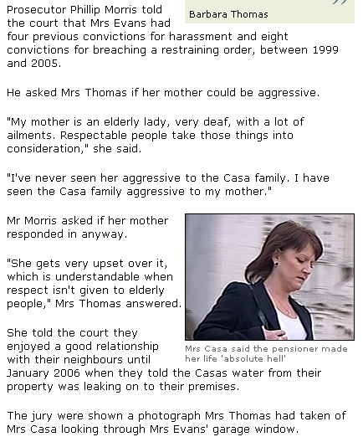
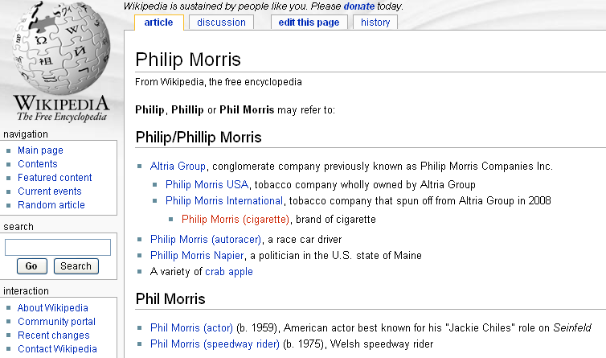
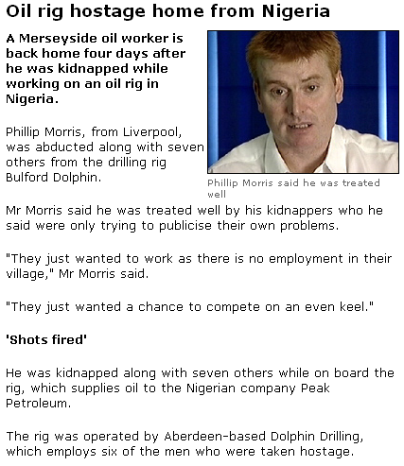
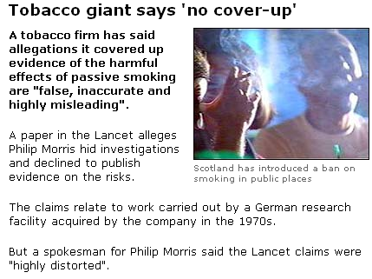
Information extraction (NER - examples)

Slide 34
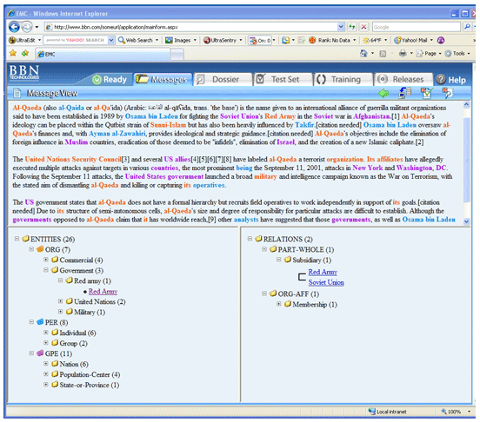
Information extraction (NER - examples)

Slide 35
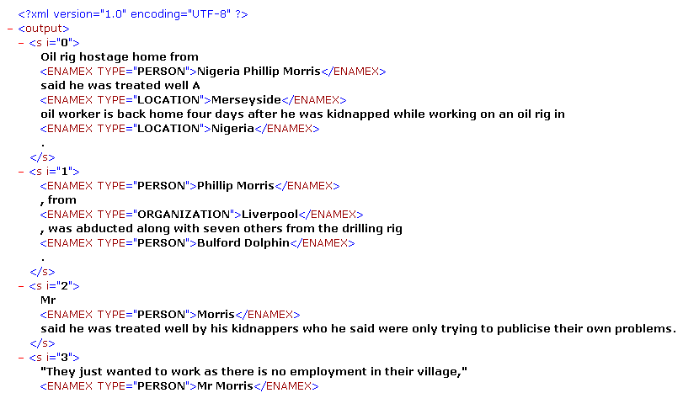
Information extraction (NER - examples)

Slide 36
Information extraction
Named Entity Recognition (NER):
  People, places, companies, organizations, products, etc.
  Biomedical domain: genes, proteins, diseases, drugs, etc.
  Use of list of terms (lexicon)
  Morphological features, e.g. capitalized letters
  Part-of-Speech tags
  Disambiguation by context and coreference

Slide 37
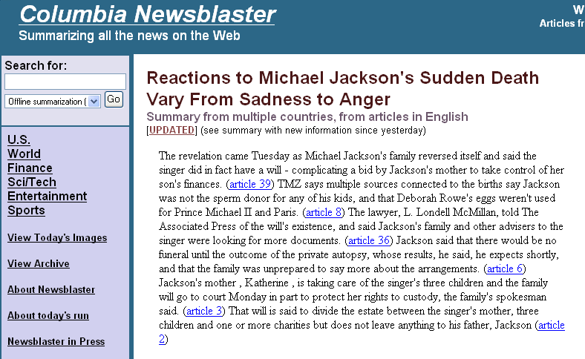
Information extraction (document summarization)

Slide 38
Information extraction (document summarization)
Document summarization
  Input: one or more documents
  Output: shorter document which contains the most important content
  “Importance” may reflect user requirements: topics, keywords, etc.
  Generic: overall sense of a document’s contents
  Query-relevant: contents relevant to a query

Slide 39
Information extraction (document summarization)
  Sentence selection
    Sentence ranking
    Mix of linguistic knowledge and statistical methods
    Corpus of annotated documents
    “Summary Sentences” must contain new information: indefinite articles, full proper names instead of pronouns, conclusions (“finally”), first and last paragraphs, acronyms with parenthesized explanation
    Order them in a coherent way

Slide 40
Information extraction (document summarization)
  Paragraph selection
    Resulting summary is often disjoint and do not read well
    Best for news: first paragraph summary of who did what to whom, where and when
    Vector space model to each paragraph
    Cosine similarity in order to find linked paragraphs

Slide 41
Information extraction (document summarization)
  Discourse based
    Model the structure of the documents
    “text grammar”: segments of the text are arranged in a network of links and nodes
    Recognize the presence or absence of key segments

Slide 42
Information extraction (document summarization)
  Coreference based
    Linguistic expressions that refer to the same entity
    “Bill Gates”, “Gates”, “he”, “Microsoft Chairman”, “the billionaire”, etc
    Combination of string matching, acronym expansion, dictionary lookup

Slide 43
Information extraction (document summarization)
  Multi-document
    More real text mining
    Identify themes in the collection
    Construct summaries of each of the themes
    Organize them in a final multi-document summary

Slide 44
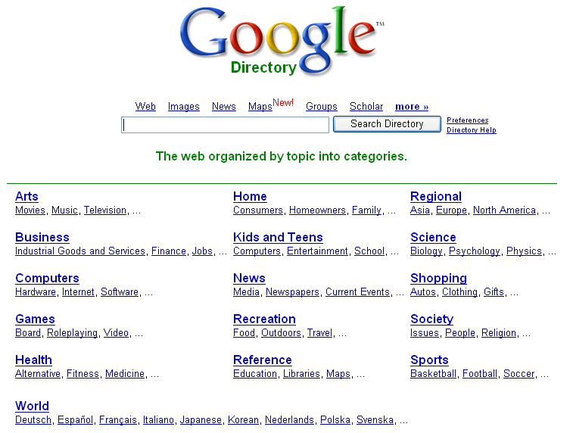
Text categorization

Slide 45
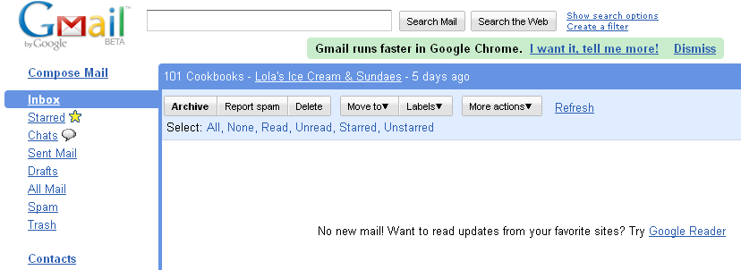
Text categorization

Slide 46
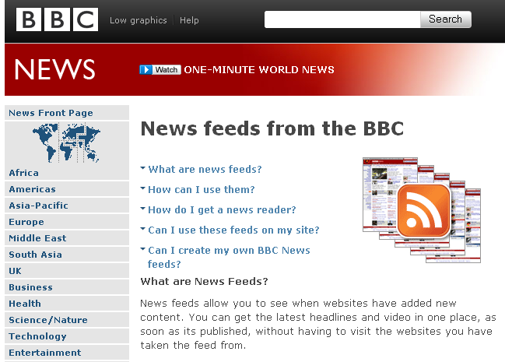
Text categorization

Slide 47
Text categorization (overview)
Also referred as “text classification”
Categories or classes
Granularity: Binary versus multiple classes
Dimensionality: number of features – all words in the document versus keywords
Exclusivity: single/disjoint versus multiple/hierarchical classes
Manual definition of classes,
Manual categorization of training documents,
Automatic categorization
Manual definition
of classes and
categorization
Handmade classifiers
Machine learning classifiers
Clustering of
documents
Manual
Hybrid
Automatic

Slide 48
Text categorization (other issues)
Data requirements
  Availability of categorized documents (training)
  Quality and quantity
Scale
  High number of categories
  Performance and accuracy problems
Mode of operation
  Batch (training)
  Online (testing, running)

Slide 49
Text categorization (handmade classifiers)
Hand-written rules (expert systems)
Examples:
  Routing (news feed)
  Spam filtering
Advantage:
  No “black-box” system
Disadvantages:
  Time-consuming
  Not scalable for many categories

Slide 50
Text categorization (machine learning classifiers)
Supervised learning
  Previous definition of classes
  n>2 classes = n binary classifiers
  Training: manually classified documents
  Naïve Bayes, Linear Classifiers, Decision trees, KNN, Support Vector Machines, Hybrid Classifiers, Neural Networks, etc.
Unsupervised learning
  No previous definition of classes
  No training annotated documents
  Clustering of documents

Slide 51
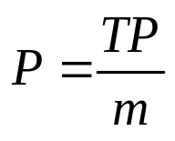
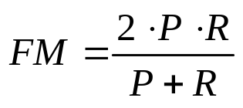
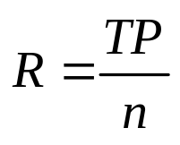
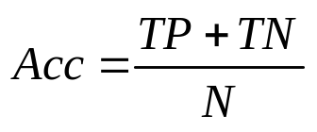
Text categorization (evaluation – binary classifier)
Contingency table
Category c |  | Gold Standard |  | Total
 |  | YES | NO
Classifier | YES | TP | FP | M
 | NO | FN | TN | N – m
Total |  | n | N - n | N
Precision: proportion of documents for which the classifier correctly assigned category c
Recall: proportion of target document correctly classified
F-Measure: harmonic average between precision and recall
Accuracy: proportion of correct answers

Slide 52
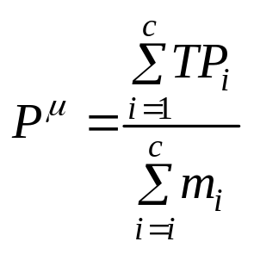
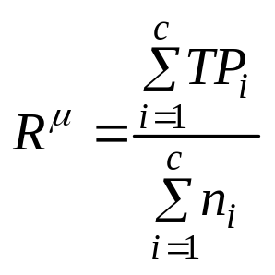
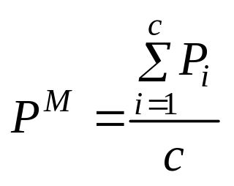
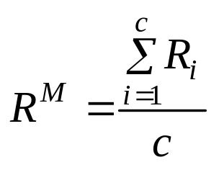
Text categorization (evaluation – overall performance)
Micro-averaging
  Global contingency table
  It gives more importance to more densely populated classes
Macro-averaging
  Average of the sum of the precision/recall
  It gives equal importance to all classes

